Slide 1
WELCOME

Slide 2
ROCK PAPER AND SCISSOR
Section Name:B02 Group No:
Project Team Names:
S.NO | APPLICATION NUMBER | REGISTER NUMBER | NAME
1 | 202307030 | 9923008040 | P. LINU ZENAS PAUL
2 | 202307103 | 9923005171 | K. VEERA GOPI
Guided by
J.Jayabharathi Mam

Slide 3
INTRODUCTION
WELCOME TO THE PRESENTATION ON ROCK PAPER AND SCISSOR GAME IN C
In this session, will delve into the intricacies of developing a robust and efficient rock paper and scissor game using C language.
We will cover key concepts, algorithms, and best practices to create an engaging and interactive game.
Before diving into the code, let’s ensure a clear understanding of rules of game.

Slide 4
OBJECTIVES OF THE PROJECT
Rock, paper, scissors is a classic game, and creating a simple version in C can be a great exercise.
This program prompts the user to enter their choice(0 for Rock,1 for Paper,3 for Scissor)
It generates a random choice for the computer, compares the choices, and declares the winner.
The objective of game is to create a program that allows the user to play the game against the computer.

Slide 5
MODULES/OPERATION/FEATURES
User Input Module
Computer Choice Module
Comparison Module
Result Display Module
Game Loop Module

Slide 6
FLOWCHART OF THE PROJECT
Start
Initialize variables (userChoice, computerChoice, result)
Display game instructions
Repeat until the user wants to 3 times
[User selects Rock, Paper, or Scissors]
[Generate random number for computer choice]
[Determine winner (userChoice vs. computerChoice)]
[Display result]
Ask if the user wants to play again]
END
.

Slide 7
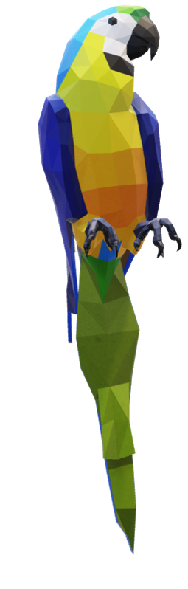
CONCEPTS APPLIED
Keywords
Header Files
Conditional statements
Functions
Loops
Basic Input/Output
Random Number Generations
User Input

Slide 8
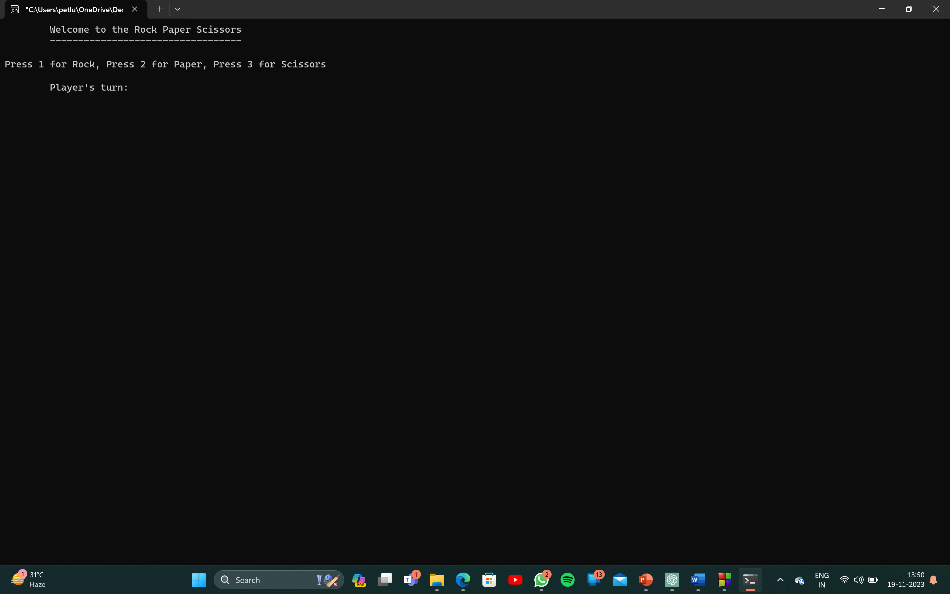
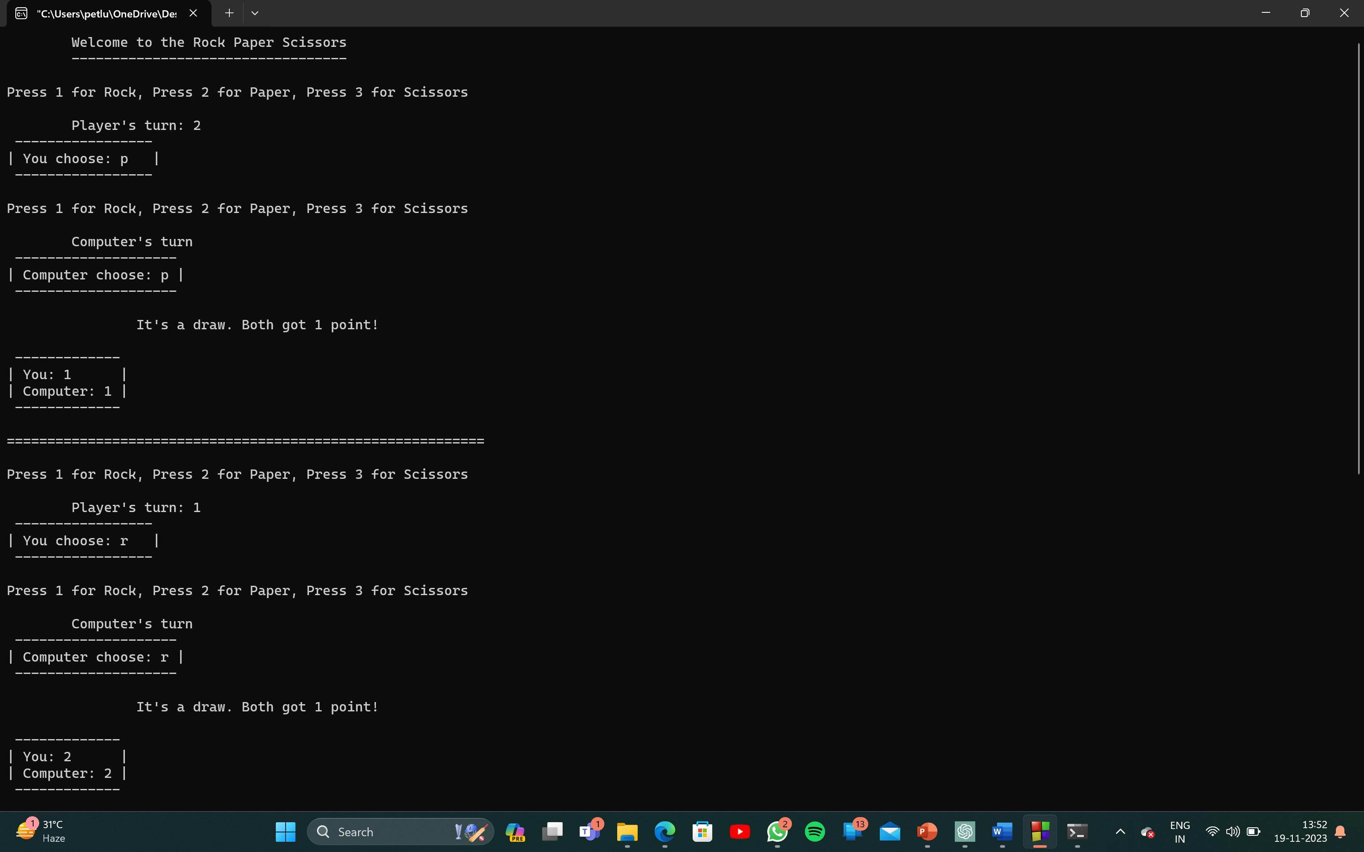
IMPLEMENTATION SCREENSHOTS

Slide 9
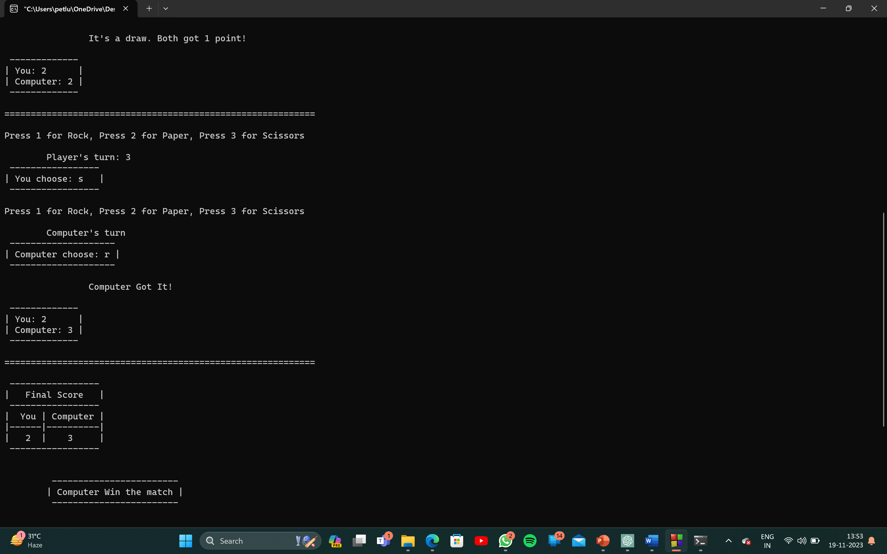

Slide 10
CONCLUSION
We have explored the rules, design considerations, logic implementation, user input handling, feature additions, and performance optimization . With this knowledge, you are well-equipped to create your own interactive and enjoyable games. Thank you for joining this session!

Slide 11
THANK YOU

